Slide 1
Intro to Rocketry

Slide 2
What is a rocket?
According to NASA, a rocket is “A vehicle, typically cylindrical, containing liquid or solid propellants which produce hot gases or ions that are ejected rearward through a nozzle.”
Notes:
Have the kids answer the question first
What is difference between rocket and airplane?

Slide 3
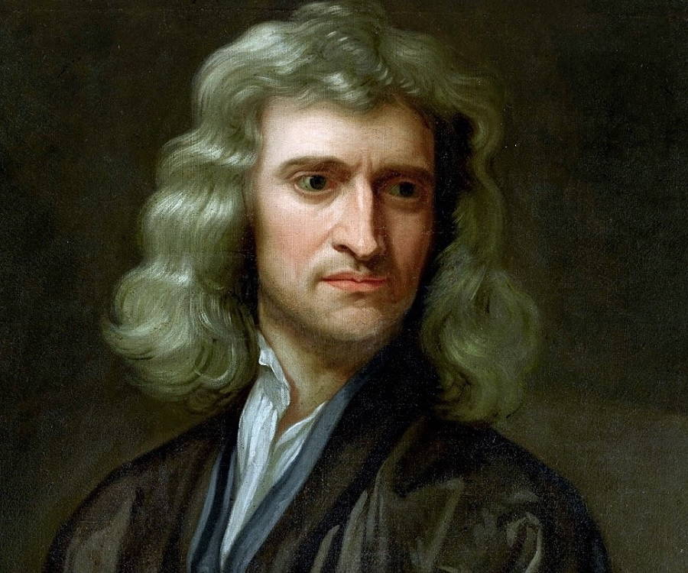
Newton’s Laws of Motion
An object at rest or at constant velocity will remains so until acted upon by an external force. (Law of inertia)
The net force on an object equals the force applied times its acceleration. (F = ma)
For every action, there is an equal and opposite reaction.
Notes:
How do these three laws relate to rocketry?

Slide 4
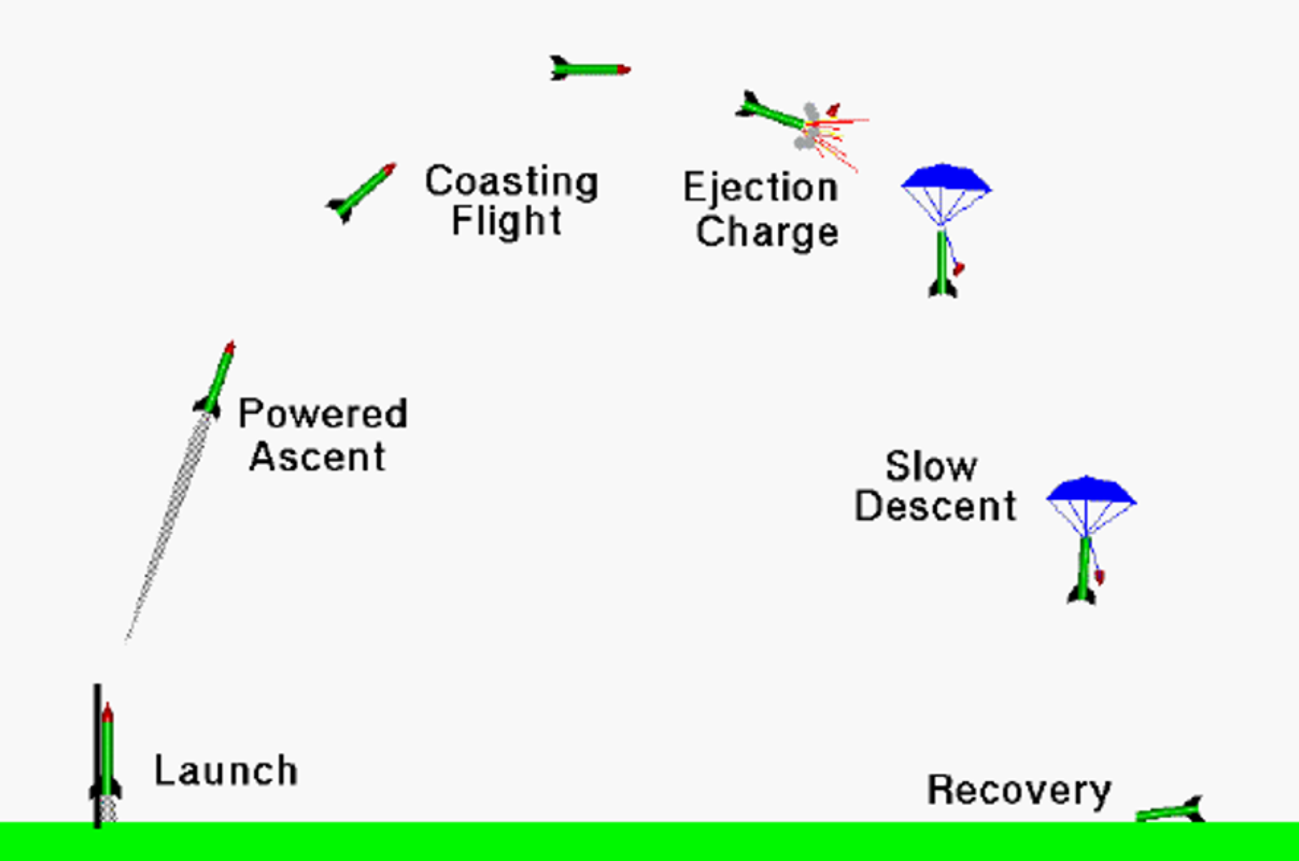
Flight of a Model Rocket
Notes:
Talk about velocity and acceleration at each point

Slide 5
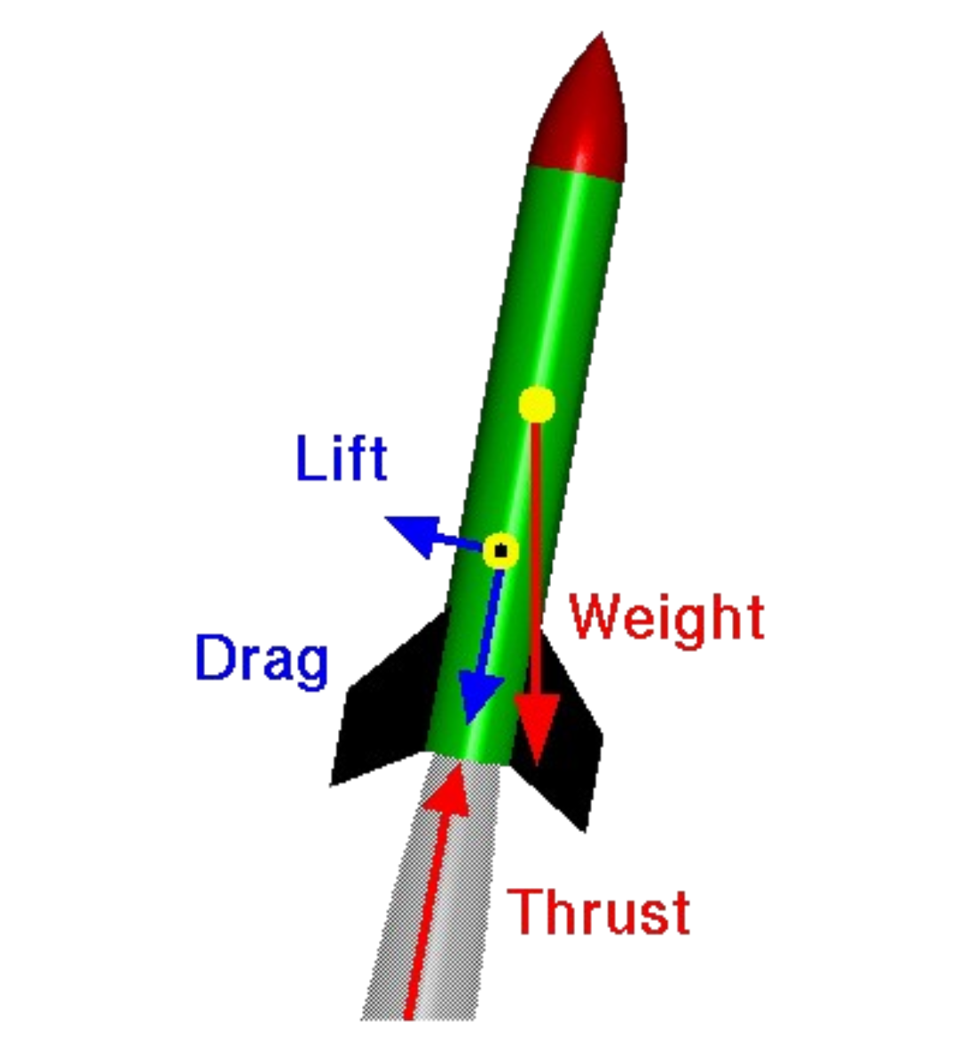
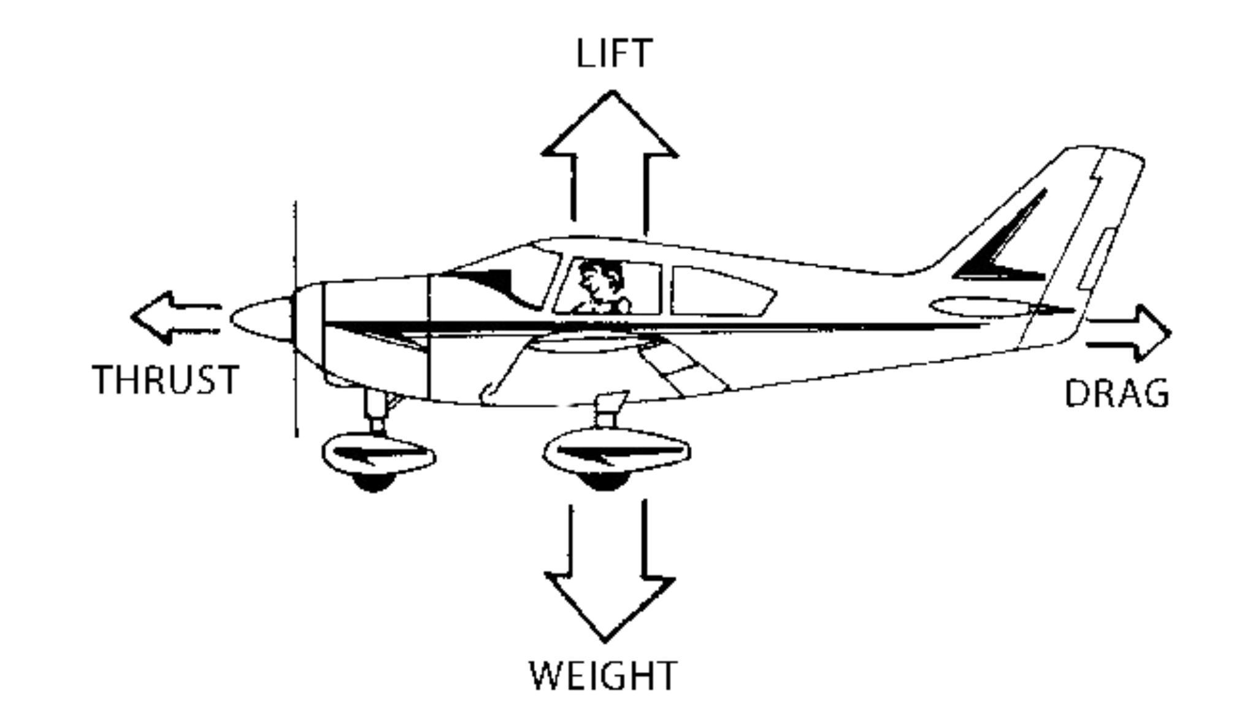
Forces on a Rocket and Airplane
Notes:
Drag – depends on surface area
Lift – less relevant on rockets, but is due to fins – caused by angle of attack

Slide 6
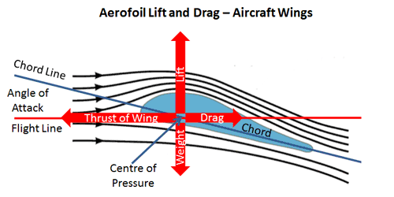
Lift Force
Notes:
Drag – depends on surface area
Lift – less relevant on rockets, but is due to fins – caused by angle of attack

Slide 7
Aerodynamics of Flight
The Object:
Shape
Size
The Motion:
Velocity
Angle to airflow
The Air:
Viscosity
Density
Compressibility

Slide 8
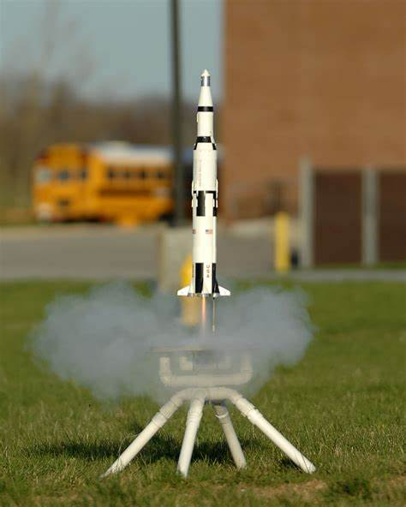
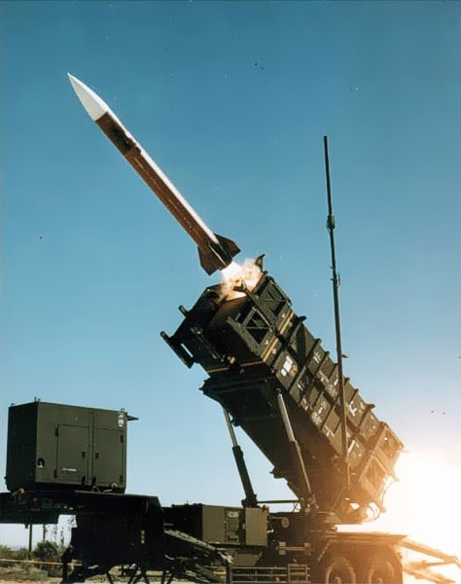
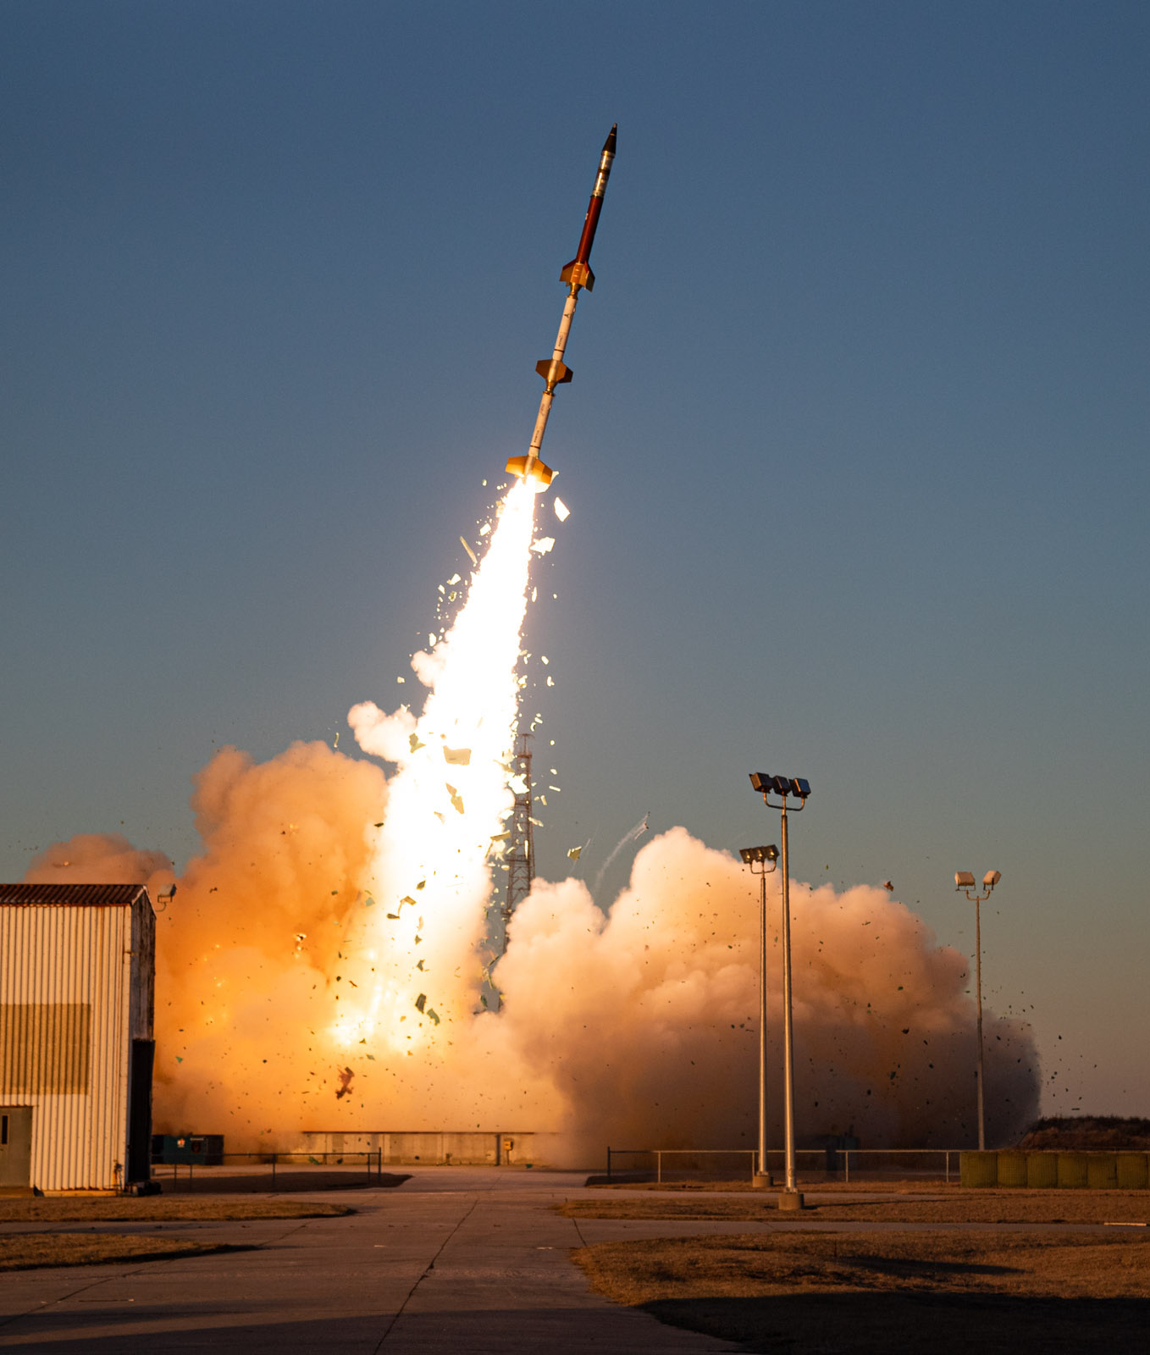
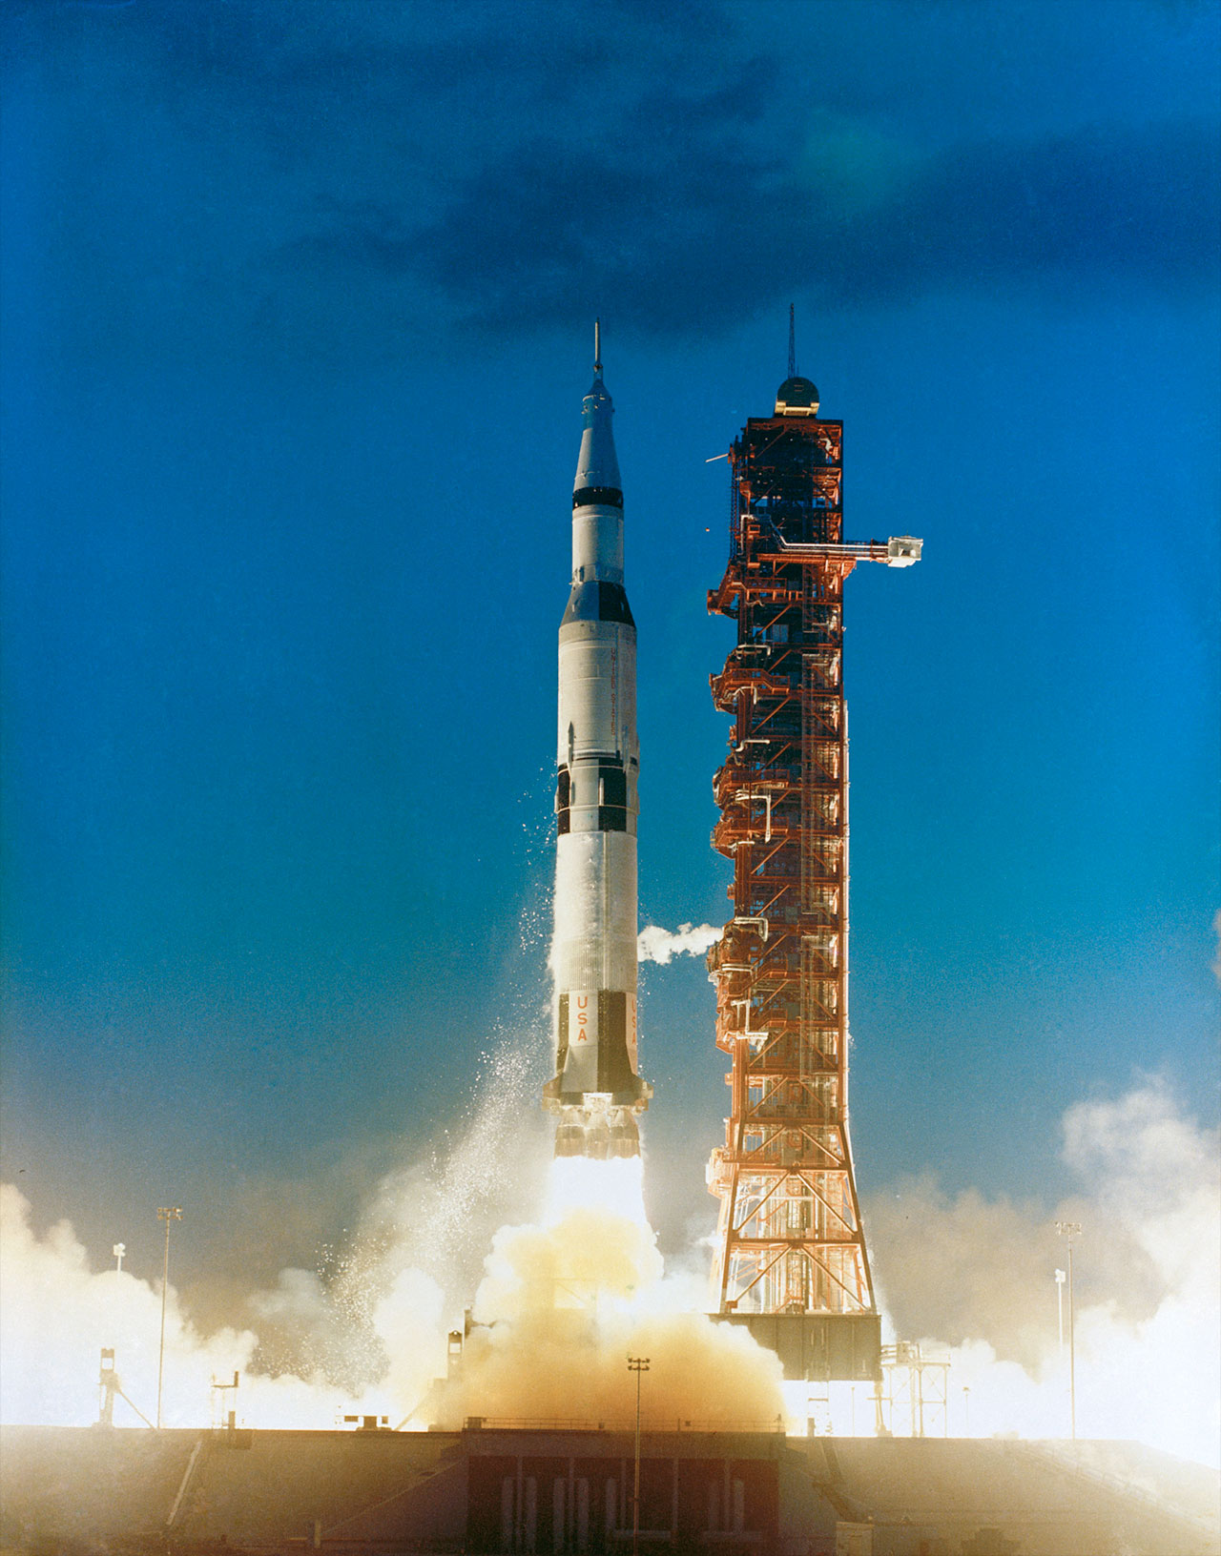
Uses of Rocketry
Hobby
Missles
Sounding Rockets
Launch Vehicles
Notes:
Sounding rockets – Rockets carrying scientific instruments into the upper atmosphere to take measurements of things like air quality and radiation in the air

Slide 9
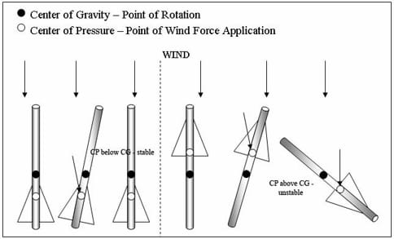
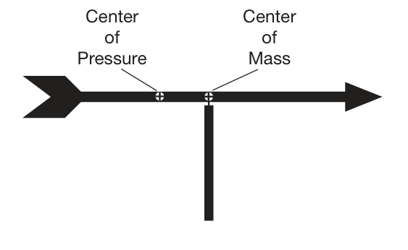
Rocket Stability
Notes:
Spin stabilization too

